Slide 1
Salmon River Joint School District
Supplemental Levy Election
August 30, 2022

Slide 2
Welcome to Our Town Hall Meeting
Agenda
Call to Order
Flag Salute
Ground Rules
Introduction of Board Members
Finance Presentation
ESSR Funds
Budget
Audit
Frequently Asked Questions Presentation
Levy Info
School Funding
Library Books
Public Comment- Q & A
Adjourn

Slide 3
Purpose
To clarify misinformation on key issues, open lines of communication and be transparent to stakeholders.

Slide 4
Ground Rules
Be courteous
-listen to others, avoid side talk and cell phone use
Be respectful
-Treat others with respect, as you wish to be treated
Be patient
-Please hold all questions and comments until the end
-Wait your turn to talk
-Please do not yell out while someone else is talking
-Please keep questions and comments to 3 minutes

Slide 5
Budget Presentation
by Business Manager Michelle Hollon
ESSR Funds Overview
Multiple ESSR Funds each with its own regulations
What have we spent ESSR funds on? Tables, desks, laptops, security cameras, Ipads…
School districts are audited every year as part of checks and balances by outside auditors. The auditors suggest every year to keep at least 3 months of operating costs in reserve in case something happens. Also, we only get money from the State at select times per year, so we have to have operating reserve to pay bills, salaries, etc in between times. In addition, we try to keep some money to fix big ticket items. Right now, we need our roofs fixed. We have savings to fix the roofs. We don't get extra money when things break or need replaced. If we didn't save for these types of repairs, we have to run a bond. That's more money out of taxpayers pockets. We don't want that.
Why aren’t we using it instead of a levy? ESSR funds have certain regulations associated with them. For example, learning loss, SEL…
2022-23 Budget & June 22 Audit can be found on the website www.jsd243.org
Select “Board of Trustees” tab, “Finances”, “Budget/Audits”
The audit will be presented on Monday the 22nd at 6:00pm at the regular board meeting.

Slide 6
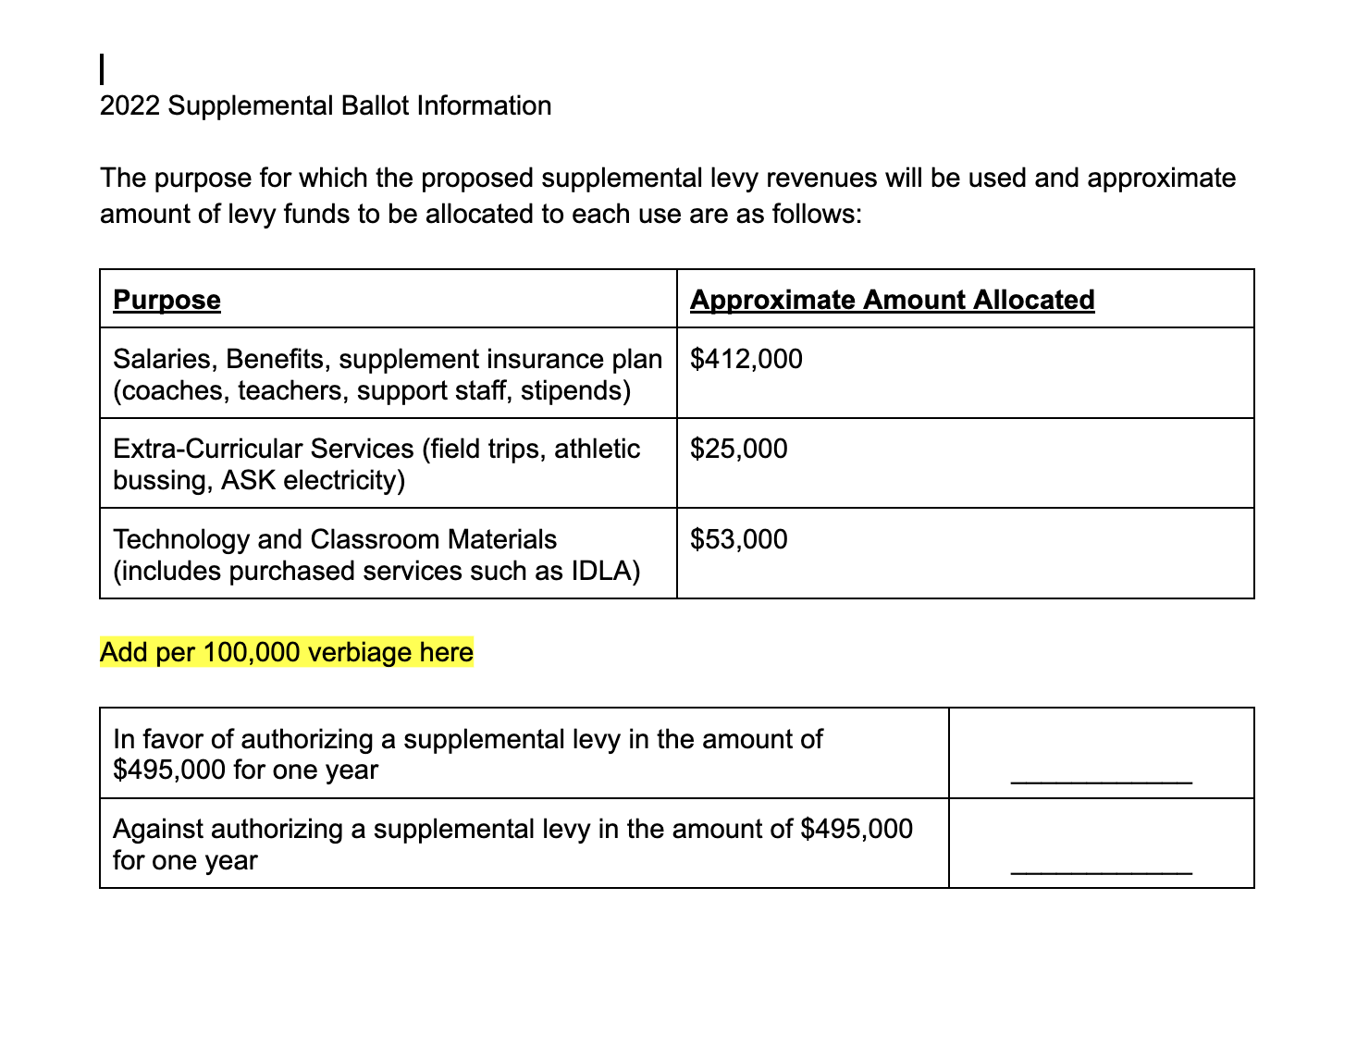
The majority of the districts budget is in salaries and benefits. The State does not fund salaries for coaches, or the IDLA teacher. Special education, Ag and Career Tech classes and preschool are only minimally funded. Insurance goes up every year and is only partially funded by the State.
Without IDLA, we could not be accredited, nor be able to provide electives.

Slide 7
Frequently Asked Questions Presentation
By Superintendent Trish Simonson
Why do we need a supplemental levy?
Idaho does not fund or fully fund;
Extra Curricular Activities (no sports or clubs)
Coaches Salaries
IDLA
IDLA Coordinator
Ag/FFA and Career Technical Education
Special Education
Preschool
Staff benefits
Curriculum
Building Repairs

Slide 8
IDAHO’S SUPPLEMENTAL LEVIES
Supplemental levies have become a key piece of Idaho’s education funding puzzle-
Local Funding=Local Control
2021 5th successive year of record supplemental levies
Supplemental levies are no longer “supplemental,”
one- or two-year levies are needed to cover day-to-day necessities and backfill state K-12 appropriations.
92 of the state’s 115 school districts are collecting supplemental levies this year
Idaho EdNews 2021
https://www.idahoednews.org/news/idahos-supplemental-levy-bill-sets-another-record/

Slide 9
Other School District Levies 2021
Salmon River: a one-year, $495,000 supplemental levy.
Whitepine: a one-year, $880,000 supplemental levy.
Nezperce: a one-year $445,000 supplemental levy.
Cottonwood: a one-year, $250,000 supplemental levy.
Plummer-Worley: a two-year, $1,254,000 supplemental levy.
Genesee: a one-year, $1,185,000 supplemental levy.
Wendell: a two-year $1.2 million supplemental levy
Mackay: smallest levy in the state $75,000
Coeur d’Alene $20 Million
Idaho EdNews 2021 https://www.idahoednews.org/news/idahos-supplemental-levy-bill-sets-another-record/

Slide 10
How are districts and schools funded?
Idaho’s funding is based on ADA
(except for during Covid years where enrollment has been used)
A unit is worth about
$3,000 per Kindergarten ADA
$5,200 to $10,000 per Elementary (grades 1‐6) ADA
$6,500 to $10,000 per Secondary (grades 7‐12) ADA
$8,300 per Exceptional ADA (divisor of 14.5)
Average Daily Attendance (or enrollment)
2. ADA is converted to units based on grade

Slide 11
How are districts and schools funded? Cont.
Idaho Statute 33-1002
Funding Formula
Average Daily Attendance-The total state average daily attendance shall be the sum of the average daily attendance of all of the school districts of the state.
Support Units-The total state support units shall be determined by using the tables set out hereafter called computation of kindergarten support units, computation of elementary support units, computation of secondary support units, computation of exceptional education support units..
The sum of all of the total support units of all school districts of the state shall be the total state support units.

Slide 12
How are districts and schools funded? Cont.
ADA | Units Allowed
41 or more | 1 or more as computed
31 – 40.99 | 1
26 – 30.99 | .85
21 – 25.99 | .75
16 – 20.99 | .6
8 – 15.99 | .5
1 – 7.99 | count as elementary
COMPUTATION OF KINDERGARTEN SUPPORT UNITS
Notes:
This year’s kindergarten class was 18, which was converted to .6 units.

Slide 13
How are districts and schools funded? Cont.
ADA | Units Allowed
300 or more | 15
160 to 299.99 | 8.4
110 to 159.99 | 6.8
71.1 to 109.99 | 4.7
51.7 to 71.0 | 4
33.6 to 51.6 | 2.8
16.6 to 33.5 | 1.4
1.0 to 16.5 | 1
COMPUTATION OF ELEMENTARY SUPPORT UNITS
Simplified for 1-6th grade
1st-3rd and 4th-6th have slightly different divisors to compute units allowed.
RES 70
Notes:
The elementary had about 70 students which converted to 4 units.

Slide 14
How are districts and schools funded? Cont.
COMPUTATION OF SECONDARY SUPPORT UNITS
SRHS
7-12th grade
About 50
ADA | Units Allowed
200 – 299.99 | 17
100 – 199.99 | 9
99 or fewer | 8 (minimum)
Exceptional students are removed from the ADA and added back with slightly higher divisor/unit count
Notes:
The high school had about 50 students which converts to the minimum of 8 units. Even if we added all 40 of the students homeschooled in our canyon, we still wouldn’t have enough students to add another unit.

Slide 15
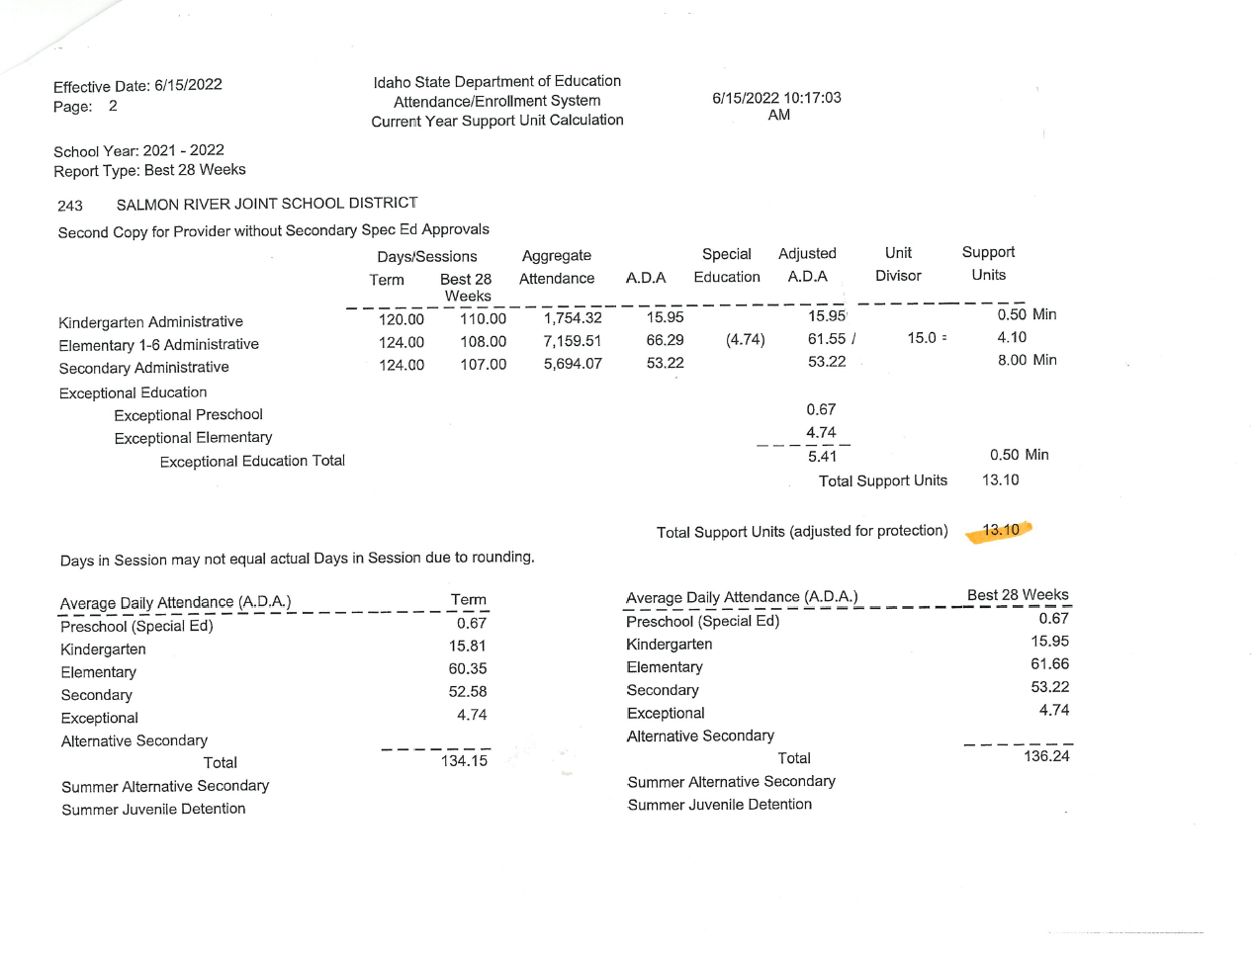
Notes:
The district ended up with a total of 13.1 units. A unit is worth about
$3,000 per Kindergarten ADA
$5,200 to $10,000 per Elementary (grades 1‐6) ADA
$6,500 to $10,000 per Secondary (grades 7‐12) ADA
$8,300 per Exceptional ADA (divisor of 14.5)

Slide 16
Question-
What if all of the homeschooled students in our district enrolled in our public schools?
We would still need a levy. If all 40 of those students went to the high school, it would raise it by about 1 unit.
Notes:
Even if we added 40 of the students homeschooled in our canyon, we still wouldn’t have enough students to add another unit.

Slide 17
What about the books?
1- Parents were given permission slips at registration
2-Parents can give the school librarian and their child's teacher a list of books they do not want their child to check out.
3- If a parent or community member does not deem a book acceptable for students, they may formally challenge the book
4- A committee will decide.
Notes- Parents may choose for students to not check out books at all, only with written permission from the parent, or an usual with no restrictions.
Challenged books are pulled for review. The committee will make the decision on each book.
Committee members are chosen randomly.

Slide 18
Simplified to save time.
If you would like more information, please contact Superintendent Trish Simonson
simonsont@jsd243.org
208-630-6027

Slide 19
Q & A Be a Part of the Solution
One speaker at a time.
You will have 3 minutes to make a comment or ask a question to allow others to also participate.
Please be polite and wait your turn.

Slide 20
Resources
Available on the table by the door;
Library Committee Application
Consideration of Curricular Materials
Idaho Public School Funding Overview

Slide 21
Adjourn
If you have any questions or concerns, please contact Superintendent Trish Simonson
simonsont@jsd243.org
208-630-6027

